Slide 1

Co-financing community-driven development through informal taxation: Experimental evidence from south-central Somalia
Vanessa van den Boogaard and Fabrizio Santoro
Research Fellows, International Centre for Tax and Development
11 May 2021

Slide 2
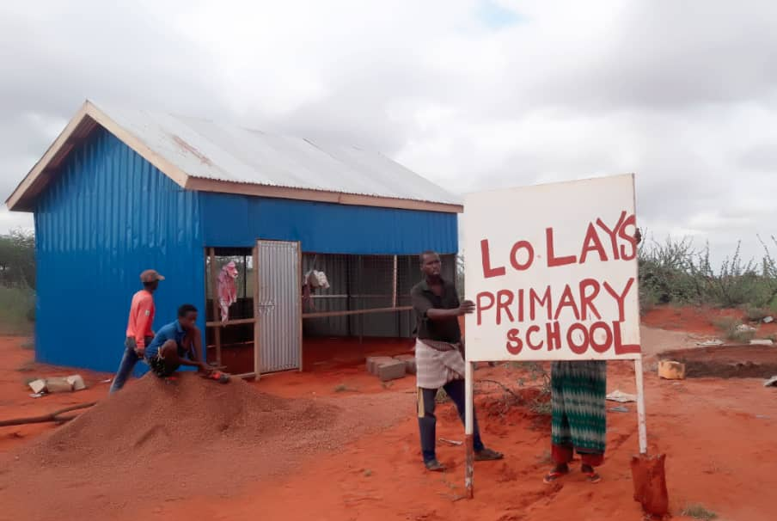
Motivation
Matching grants are commonly used to incentivize local revenue raising for local public goods projects
  Logic that increased participation increases ownership and accountability
Limited evidence of impacts
  Risk of elite capture

Slide 3
Outline and preview of key findings
Research design and data
Context of informal revenue generation in Gedo region
  Informal tax is prevalent, regressive, and complementary to local state institutions
Impacts of DIALOGUE matching grant programme:
  Increased informal contributions to public goods
  Improved public goods
  Did not crowd out other forms of local revenue raising
  Has positive spillover effects on the legitimacy of state and non-state actors
Implications for development partners

Slide 4
(1) Research design and data

Slide 5
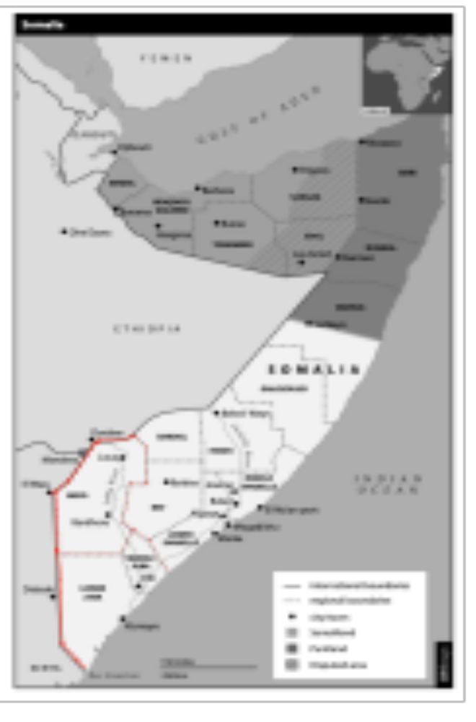
Research design
RCT of NGO-led community-level interventions
Eligibility (62 communities)
Intervention (31 communities)
  Matching grants
  Transparency requirements
  (www.sokaab.com)
Limitations to external validity:
  Opting in and collective action
  Relative security of region

Slide 6
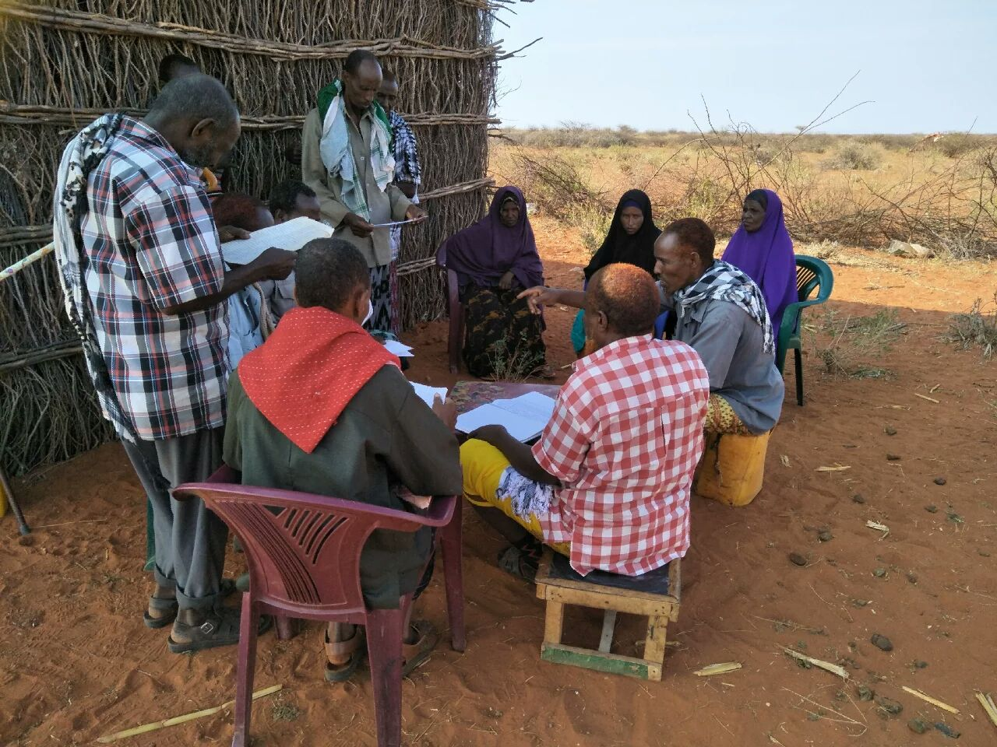
Data
Household surveys (N 1300) at baseline (March 2018) and endline (February 2019)
Community leader surveys (N 100) at baseline and endline
Directly observable community-level data captured by enumerators
Data on informal contributions and public goods expenditures recorded through mobile banking platform in treatment communities

Slide 7
(2) Context of informal revenue generation in Gedo region

Slide 8
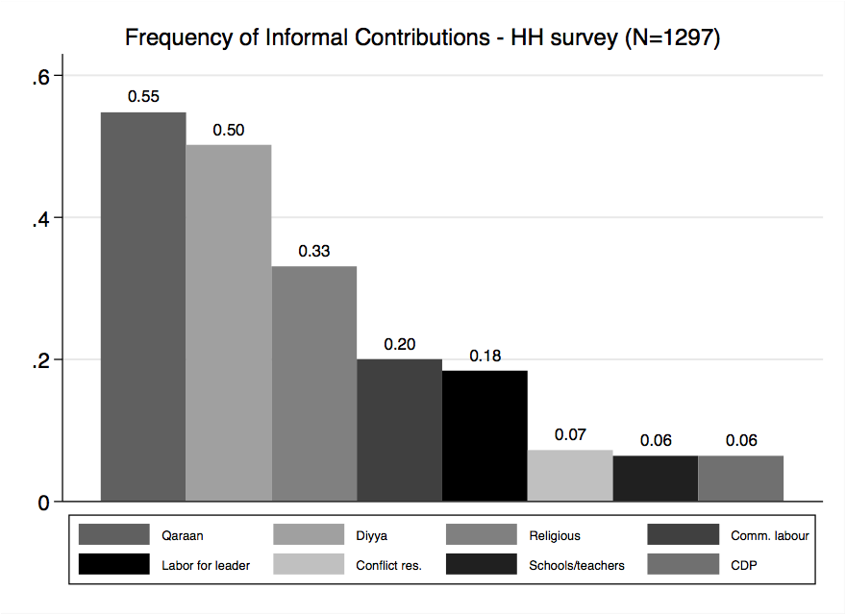
(a) Informal revenue generation is prevalent
71 percent of households paid at least one informal tax or fee in the previous year
Communities depend on informal taxes to maintain public goods
Informal payments represent on average 9.5% of income

Slide 9
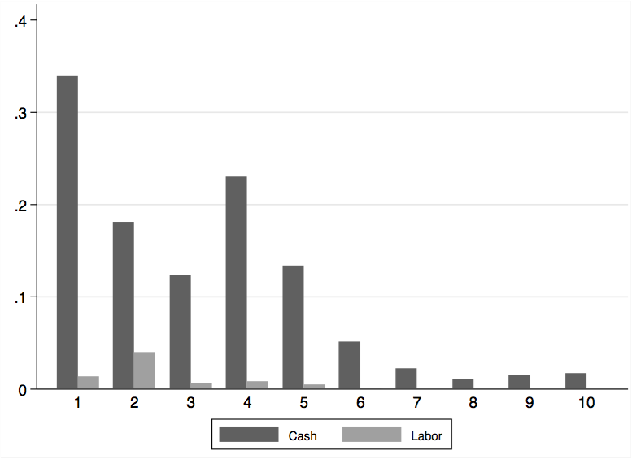
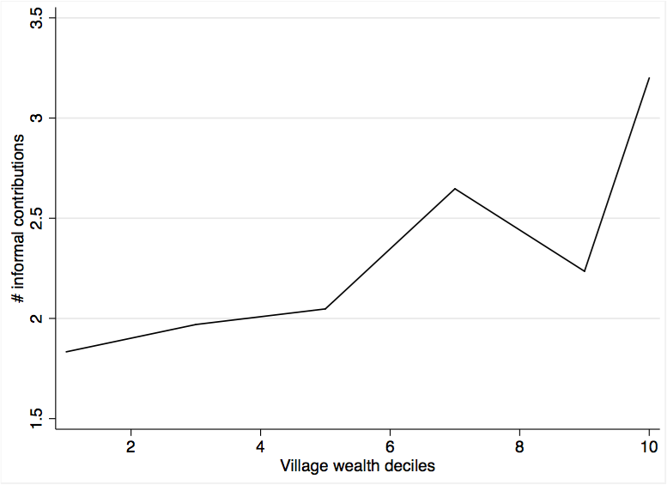
(b) Informal revenue generation is regressive
Incidence of contributions on income (%) by income deciles
Informal contributions by village wealth decile

Slide 10
(c) Informal revenue generation can complement local state institutions
Table 1. Number of informal contributions above median and tax morale
 | (1) District govt | (2) District govt | (3) Village leaders | (4) Village leaders | (5) Clan elders | (6) Clan elders | (7) Religious leaders | (8) Religious leaders
IRG | 0.15*** | 0.12*** | 0.07*** | 0.09*** | 0.09*** | 0.11*** | 0.12*** | 0.11***
 | (0.03) | (0.03) | (0.02) | (0.03) | (0.04) | (0.04) | (0.03) | (0.03)
Controls | No | Yes | No | Yes | No | Yes | No | Yes
Mean of Y | 0.52 | 0.52 | 0.76 | 0.76 | 0.73 | 0.73 | 0.71 | 0.71
R-sq. | 0.014 | 0.104 | 0.007 | 0.018 | 0.009 | 0.043 | 0.015 | 0.053
N | 1224 | 1224 | 1259 | 1259 | 1258 | 1258 | 1232 | 1232

Slide 11
(3) Impacts of DIALOGUE matching grant programme

Slide 12
(a) Effects on informal contributions to public goods
Table 2: Impact on new community development project projects
 | (1) | (2) | (3) | (4)
 | Any new project | Any new project | Log contributions to new projects (USD) | Log contributions to new projects (USD)
Dialogue | 0.13** | 0.14** | 0.68** | 0.62**
 | (0.06) | (0.06) | (0.28) | (0.28)
Controls | No | Yes | No | Yes
Village FE | Yes | Yes | Yes | Yes
Control Y endline | 0.37 | 0.37 | 6.60 | 6.60
R-sq. | 0.387 | 0.390 | 0.491 | 0.501
Observations | 880 | 880 | 1019 | 1019
Consistent results from leaders’ survey - table

Slide 13
(b) Effects on public goods outcomes
Table 3: Impact on reciprocity
 | (1) | (2) | (3) | (4)
 | Dissatisfaction with new community development projects (max=5) | Dissatisfaction with new community development projects (max=5) | Perceptions of getting something in return for informal contributions | Perceptions of getting something in return for informal contributions
Dialogue | -0.43*** | -0.45*** | 0.20** | 0.19**
 | (0.12) | (0.12) | (0.09) | (0.10)
Baseline outcome | - | - | No | Yes
Controls | No | Yes | No | Yes
Village FE | Yes | Yes | Yes | Yes
Control Y endline | 4.16 | 4.16 | 0.66 | 0.66
Control Y baseline | - | - | 0.22 | 0.22
R-sq | 0.372 | 0.375 | 0.451 | 0.471
Observations | 998 | 998 | 570 | 570
Consistent enumerators’ assessment – table and figure

Slide 14
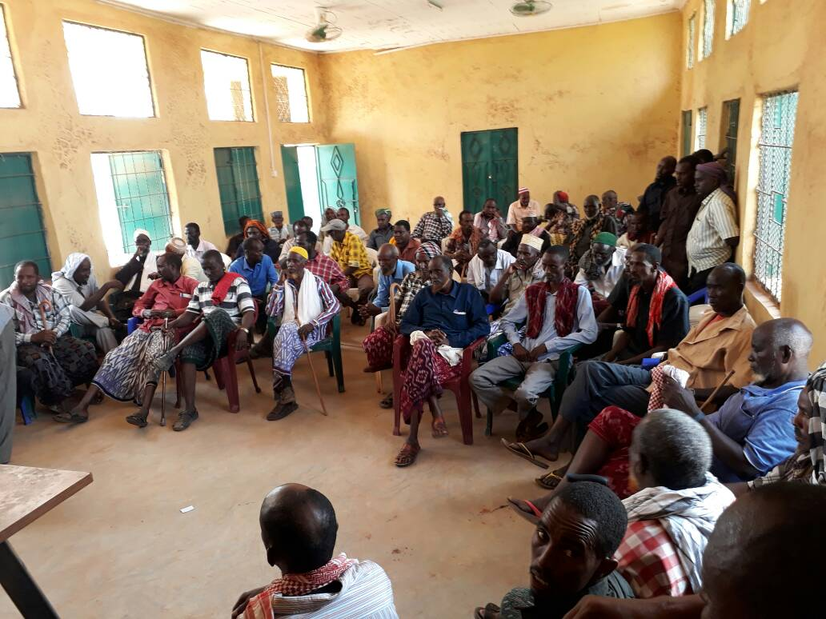
(b) Effects on public goods outcomes –Mechanisms
(1) “Answerability” hypothesis
  Strong impacts on individuals attending meetings, playing a role in monitoring community projects, asking leaders about public revenues, and raising issues with other community members - table

Slide 15
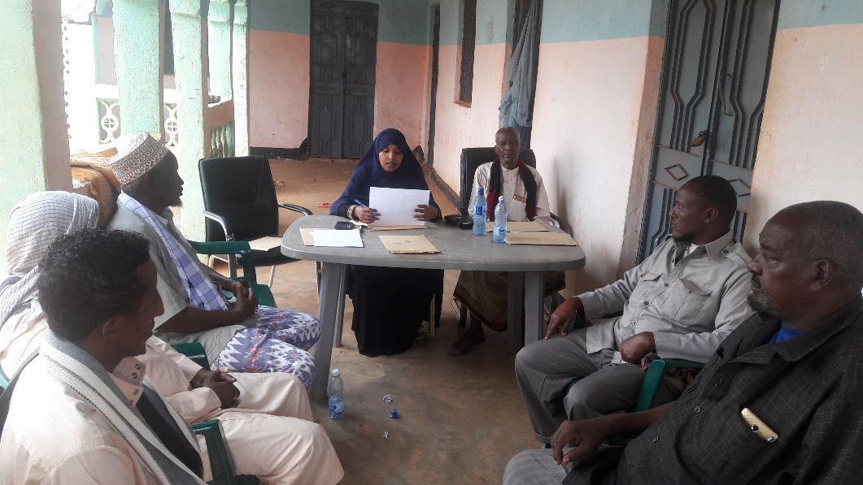
(b) Effects on public goods outcomes –Mechanisms
(2) Transparency hypothesis
  In T, more likely to report that a distinct committee had been set up to manage the project, that they had been consulted in person about the project, and that the project had been decided through a community meeting - table
  however, individuals in T report less frequent information sharing and meetings about the project - table

Slide 16
(c) Spillover effects on other revenue raising
Table 4: Impact on other informal contributions
 | (1) | (2) | (3) | (4) | (5) | (6) | (7) | (8)
 | Village leader | Village leader | Religious | Religious | Clan | Clan | Pub. goods | Pub. goods
Dialogue | -0.01 | -0.00 | 0.17*** | 0.17*** | 0.44*** | 0.44*** | 0.18* | 0.16*
 | (0.05) | (0.05) | (0.05) | (0.05) | (0.14) | (0.14) | (0.11) | (0.11)
Baseline outcome | No | Yes | No | Yes | No | Yes | No | Yes
Controls | No | Yes | No | Yes | No | Yes | No | Yes
Village FE | Yes | Yes | Yes | Yes | Yes | Yes | Yes | Yes
Control Y endline | 0.17 | 0.17 | 0.21 | 0.21 | 0.97 | 0.97 | 0.55 | 0.55
R-sq. | 0.259 | 0.263 | 0.389 | 0.398 | 0.353 | 0.364 | 0.396 | 0.403
Observations | 880 | 880 | 880 | 880 | 880 | 880 | 880 | 880

Slide 17
(d) Effects on perceptions of governance actors
Table 5: Impact on actor’s legitimacy
 | (1) | (2) | (3) | (4) | (5) | (6) | (7) | (8)
 | District | District | Village | Village | Clan | Clan | Religious | Religious
Dialogue | 0.22*** | 0.22*** | 0.03 | 0.03 | 0.19*** | 0.19*** | 0.25*** | 0.25***
 | (0.07) | (0.07) | (0.05) | (0.06) | (0.06) | (0.06) | (0.06) | (0.06)
Baseline outcome | No | Yes | No | Yes | No | Yes | No | Yes
Controls | No | Yes | No | Yes | No | Yes | No | Yes
Village FE | Yes | Yes | Yes | Yes | Yes | Yes | Yes | Yes
Control Y endline | 0.67 | 0.67 | 0.77 | 0.77 | 0.68 | 0.68 | 0.66 | 0.66
Control Y baseline | 0.45 | 0.45 | 0.65 | 0.65 | 0.66 | 0.66 | 0.61 | 0.61
R-sq. | 0.324 | 0.330 | 0.259 | 0.267 | 0.314 | 0.318 | 0.360 | 0.366
Observations | 866 | 866 | 869 | 869 | 867 | 867 | 847 | 847

Slide 18
(d) Effects on perceptions of governance actors - Mechanisms
Engagement and inclusivity
  Religious leaders and clan elders considerably improve – not the village council
Performance-based mechanism
  Strong impact on transparency of, trust into, performance of district govt and religious leaders, negative for village council
Wrong attribution
  No evidence of misattribution - figure
IRG as a mediator
  No evidence - table

Slide 19
(4) Implications and key takeaways

Slide 20
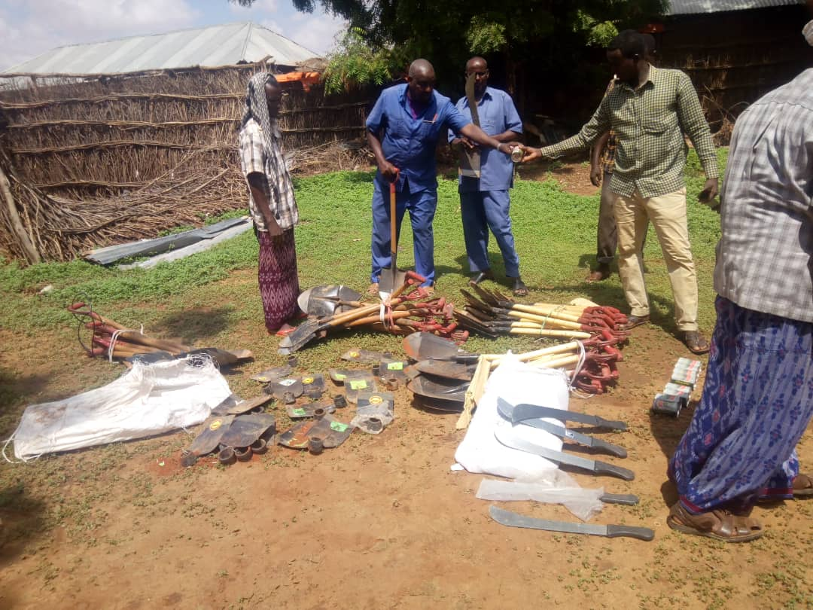
Key findings
Matching grant programme:
  Improved the quality of public goods financed through informal taxes and perceptions of the fiscal reciprocity of informal taxes
  Local state actors benefit, while the impact on non-state actors is more complex

Slide 21
Implications for development partners
Development partners may effectively work with informal institutions of revenue raising, without necessarily undermining local state institutions
Nevertheless, potential risks of incentivizing informal taxation, including:
  Reinforcing unaccountable informal institutions (risks for minorities)
  Reinforcing negative distributional impacts – figure ; baseline
  Institutionalizing non-universal access to public goods, with implications for social cohesion/ conflict - table

Slide 22
Thank you!
Vanessa van den Boogaard and Fabrizio Santoro
v.vandenboogaard@utoronto.ca, F.Santoro@ids.ac.uk
@Vvandenboogaard

Slide 23
Appendices

Slide 24
A1: Impacts on contribution – Leaders’ survey
 | (1) | (2) | (3) | (4) | (5) | (6) | (7) | (8)
 | Any new project | Any new project | HHs % Contributing | HHs % Contributing | Log Tot. Contributions (USD) | Log Tot. Contributions (USD) | Log Avg Contribution (USD) | Log Avg Contribution (USD)
Dialogue | 0.12* | 0.17** | 12.19** | 18.03*** | 1.07* | 1.45** | 0.14 | 0.16
 | (0.06) | (0.07) | (5.00) | (5.60) | (0.61) | (0.64) | (0.32) | (0.34)
Controls | No | Yes | No | Yes | No | Yes | No | Yes
Control Y endline | 0.84 | 0.84 | 25.17 | 25.17 | 5.76 | 5.76 | 3.23 | 3.23
R-sq. | 0.038 | 0.204 | 0.061 | 0.283 | 0.033 | 0.272 | 0.002 | 0.157
Observations | 98 | 98 | 93 | 93 | 92 | 92 | 91 | 91
back

Slide 25
A3.1: Observational data on the quality of projects I
 | (1) | (2) | (3) | (4) | (5) | (6) | (7) | (8)
 | Completed (L) | Completed (L) | Access (E) | Access (E) | Completed (E) | Completed (E) | High quality (E) | High quality (E)
Dialogue | -0.05 | -0.01 | 0.14 | 0.19* | 0.00 | 0.18 | 0.30** | 0.47***
 | (0.09) | (0.11) | (0.10) | (0.11) | (0.11) | (0.14) | (0.14) | (0.14)
Controls | No | Yes | No | Yes | No | Yes | No | Yes
Control Y endline | 0.76 | 0.76 | 0.44 | 0.44 | 0.82 | 0.82 | 0.27 | 0.27
R-sq. | 0.003 | 0.171 | 0.021 | 0.314 | 0.000 | 0.323 | 0.089 | 0.368
Observations | 98 | 98 | 98 | 98 | 50 | 50 | 50 | 50
back

Slide 26
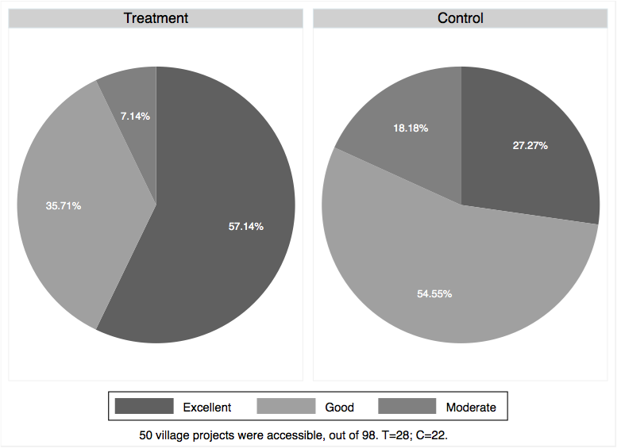
A3.2: Observational data on the quality of projects II
back

Slide 27
A4: Accountability
 | (1) | (2) | (3) | (4) | (5) | (6) | (7) | (8)
 | Attend meeting | Attend meeting | Monitor community project | Monitor community project | Ask abt revenues | Ask abt revenues | Raise issue wt other villagers | Raise issue wt other villagers
Dialogue | 0.13*** | 0.14*** | 0.11** | 0.11** | 0.18*** | 0.18*** | 0.16*** | 0.16***
 | (0.05) | (0.05) | (0.05) | (0.05) | (0.05) | (0.05) | (0.05) | (0.05)
Baseline outcome | No | Yes | No | Yes | No | Yes | No | Yes
Controls | No | Yes | No | Yes | No | Yes | No | Yes
Village FE | Yes | Yes | Yes | Yes | Yes | Yes | Yes | Yes
Control Y endline | 0.84 | 0.84 | 0.83 | 0.83 | 0.80 | 0.80 | 0.83 | 0.83
Control Y baseline | 0.26 | 0.26 | 0.09 | 0.09 | 0.16 | 0.16 | 0.16 | 0.16
R-sq. | 0.406 | 0.415 | 0.432 | 0.441 | 0.417 | 0.426 | 0.426 | 0.443
Obs. | 880 | 880 | 880 | 880 | 880 | 880 | 880 | 880
back

Slide 28
A5.1: Transparency
 | (1) | (2) | (3) | (4) | (5) | (6)
 | Project committee formed | Project committee formed | Resp. Consulted | Resp. Consulted | Community decision | Community decision
Dialogue | 0.22*** | 0.20*** | 0.18*** | 0.17*** | 0.09 | 0.10*
 | (0.06) | (0.06) | (0.05) | (0.05) | (0.05) | (0.05)
Controls | No | Yes | No | Yes | No | Yes
Village FE | Yes | Yes | Yes | Yes | Yes | Yes
Control Y endline | 0.33 | 0.33 | 0.38 | 0.38 | 0.35 | 0.35
R-sq. | 0.413 | 0.423 | 0.344 | 0.350 | 0.421 | 0.428
Obs. | 957 | 957 | 1030 | 1030 | 1030 | 1030
back

Slide 29
A5.2: Transparency
 | (1) | (2) | (3) | (4)
 | Sharing Info Frequency (max=7) | Sharing Info Frequency (max=7) | Meeting Frequency (max=7) | Meeting Frequency (max=7)
Dialogue | -0.45** | -0.45** | -0.73*** | -0.77***
 | (0.22) | (0.22) | (0.23) | (0.23)
Controls | No | Yes | No | Yes
Village FE | Yes | Yes | Yes | Yes
Control Y endline | 4.30 | 4.30 | 4.25 | 4.25
R-sq. | 0.392 | 0.397 | 0.373 | 0.382
Observations | 1030 | 1030 | 1030 | 1030
back

Slide 30
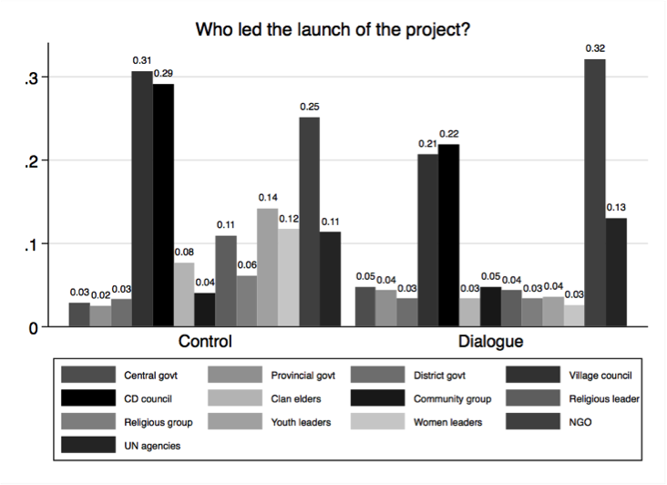
A6: Misattribution
back

Slide 31
A7: IRG as a mediator
 | (1) | (2) | (3) | (4) | (5) | (6) | (7) | (8)
 | District | District | Village | Village | Clan | Clan | Religious | Religious
Dialogue | 0.23*** | 0.23*** | -0.00 | -0.00 | 0.16** | 0.16** | 0.23*** | 0.23***
 | (0.07) | (0.07) | (0.06) | (0.06) | (0.07) | (0.07) | (0.07) | (0.07)
Dialogue*IRG | -0.05 | -0.03 | 0.09 | 0.09 | 0.06 | 0.06 | -0.03 | -0.02
 | (0.08) | (0.08) | (0.08) | (0.08) | (0.08) | (0.08) | (0.07) | (0.07)
IRG | 0.01 | 0.01 | -0.04 | -0.05 | 0.03 | 0.03 | 0.12** | 0.12**
 | (0.05) | (0.05) | (0.06) | (0.06) | (0.06) | (0.06) | (0.06) | (0.06)
Baseline outcome | No | Yes | No | Yes | No | Yes | No | Yes
Controls | No | Yes | No | Yes | No | Yes | No | Yes
Village FE | Yes | Yes | Yes | Yes | Yes | Yes | Yes | Yes
Control Y endline | 0.67 | 0.67 | 0.77 | 0.77 | 0.68 | 0.68 | 0.66 | 0.66
Control Y baseline | 0.45 | 0.45 | 0.65 | 0.65 | 0.66 | 0.66 | 0.61 | 0.61
R-sq. | 0.324 | 0.330 | 0.261 | 0.268 | 0.318 | 0.321 | 0.370 | 0.376
Obs. | 866 | 866 | 869 | 869 | 867 | 867 | 847 | 847
back

Slide 32
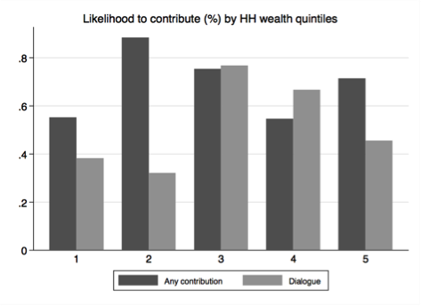
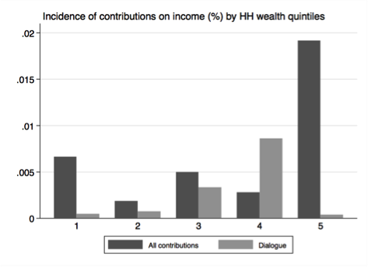
A8.1: Equity
back

Slide 33
A8.2: Equity from WP 118
Incidence of contributions on income (%) by income deciles
Informal contributions by village wealth decile
back

Slide 34
A9: Social cohesion
 | (1) | (2) | (3) | (4) | (5) | (6) | (7) | (8)
 | Public Lottery | Public Lottery | Resentment | Resentment | Trust in other clans | Trust in other clans | Unhappy | Unhappy
Dialogue | -0.04 | -0.04 | 0.10* | 0.11* | -0.04 | -0.03 | -0.19*** | -0.19***
 | (0.05) | (0.05) | (0.06) | (0.06) | (0.06) | (0.06) | (0.06) | (0.06)
Controls | No | Yes | No | Yes | No | Yes | No | Yes
Village FE | Yes | Yes | Yes | Yes | Yes | Yes | Yes | Yes
Control Y endline | 0.83 | 0.83 | 0.43 | 0.43 | 0.79 | 0.79 | 0.30 | 0.30
Control Y baseline | - | - | - | - | 0.83 | 0.83 | - | -
R-sq. | 0.358 | 0.361 | 0.394 | 0.397 | 0.258 | 0.271 | 0.382 | 0.389
Obs. | 880 | 880 | 880 | 880 | 872 | 872 | 880 | 880
back

